Slide 1
Applied Probability I Topic 4 – Discrete Random Variables
Dr. Bahman Honari
Fall 2020

Slide 2
Discrete Random Variables
In this set of slides, we introduce a couple of discrete random variables and discuss their properties.

Slide 3
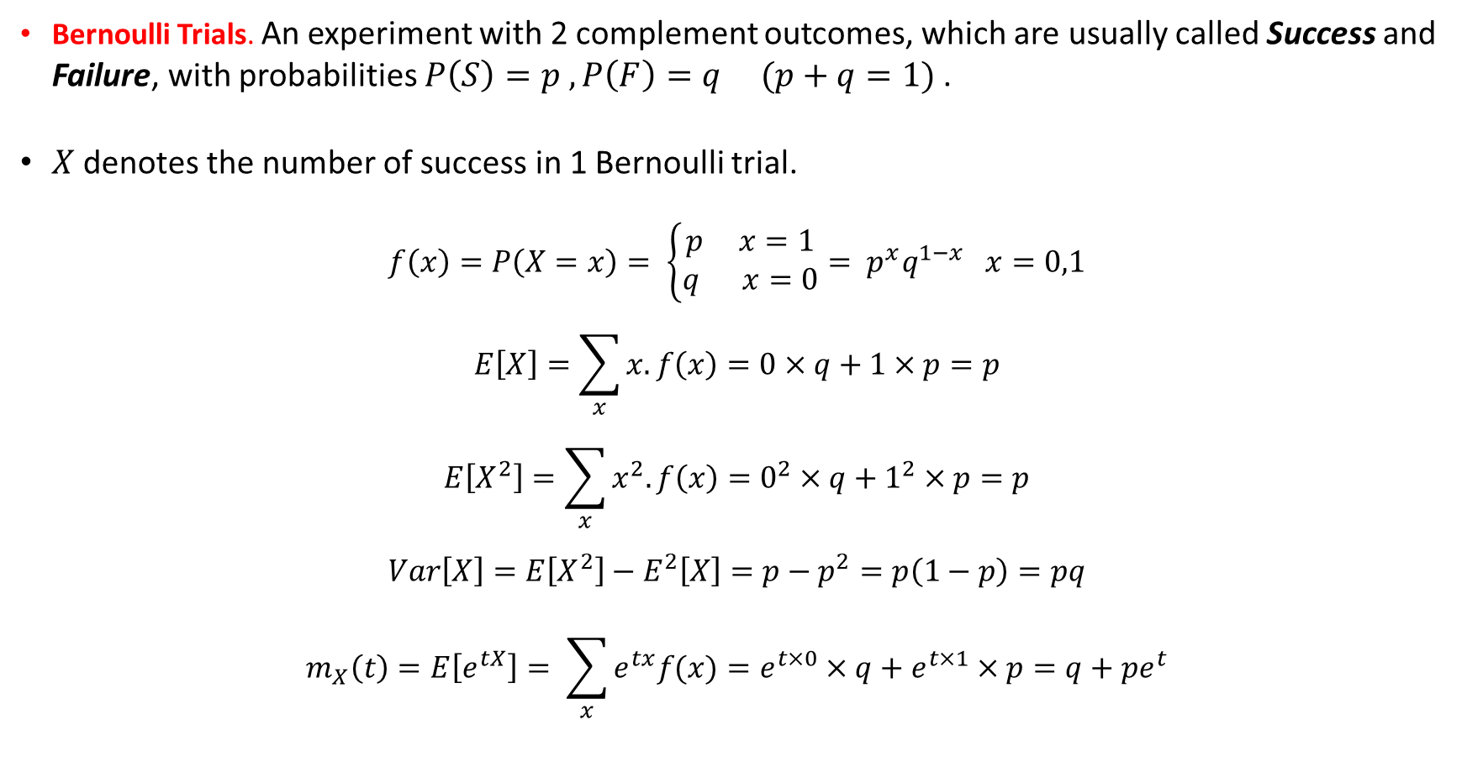
1- Bernoulli Distribution
Bernoulli Trials. An experiment with 2 complement outcomes, which are usually called Success and Failure, with probabilities $P\left(S\right)=p , P\left(F\right)=q (p+q=1)$.
$X$ denotes the number of success in 1 Bernoulli trial.
$$f\left(x\right)=P\left(X=x\right)= \left\{\begin{matrix}p x=1 \\ q x=0\end{matrix}\right.= p^{x}q^{1−x} x=0,1$$
$$E\left[X\right]=\sum_{x}{x. f\left(x\right)}=0×q+1×p=p$$
$$E\left[X^{2}\right]=\sum_{x}{x^{2}. f\left(x\right)}=0^{2}×q+1^{2}×p=p$$
$$Var\left[X\right]=E\left[X^{2}\right]−E^{2}\left[X\right]=p−p^{2}=p\left(1−p\right)=pq$$
$$m_{X}\left(t\right)=E\left[e^{tX}\right]= \sum_{x}{e^{tx}f(x)}=e^{t×0}×q+e^{t×1}×p=q+pe^{t}$$

Slide 4
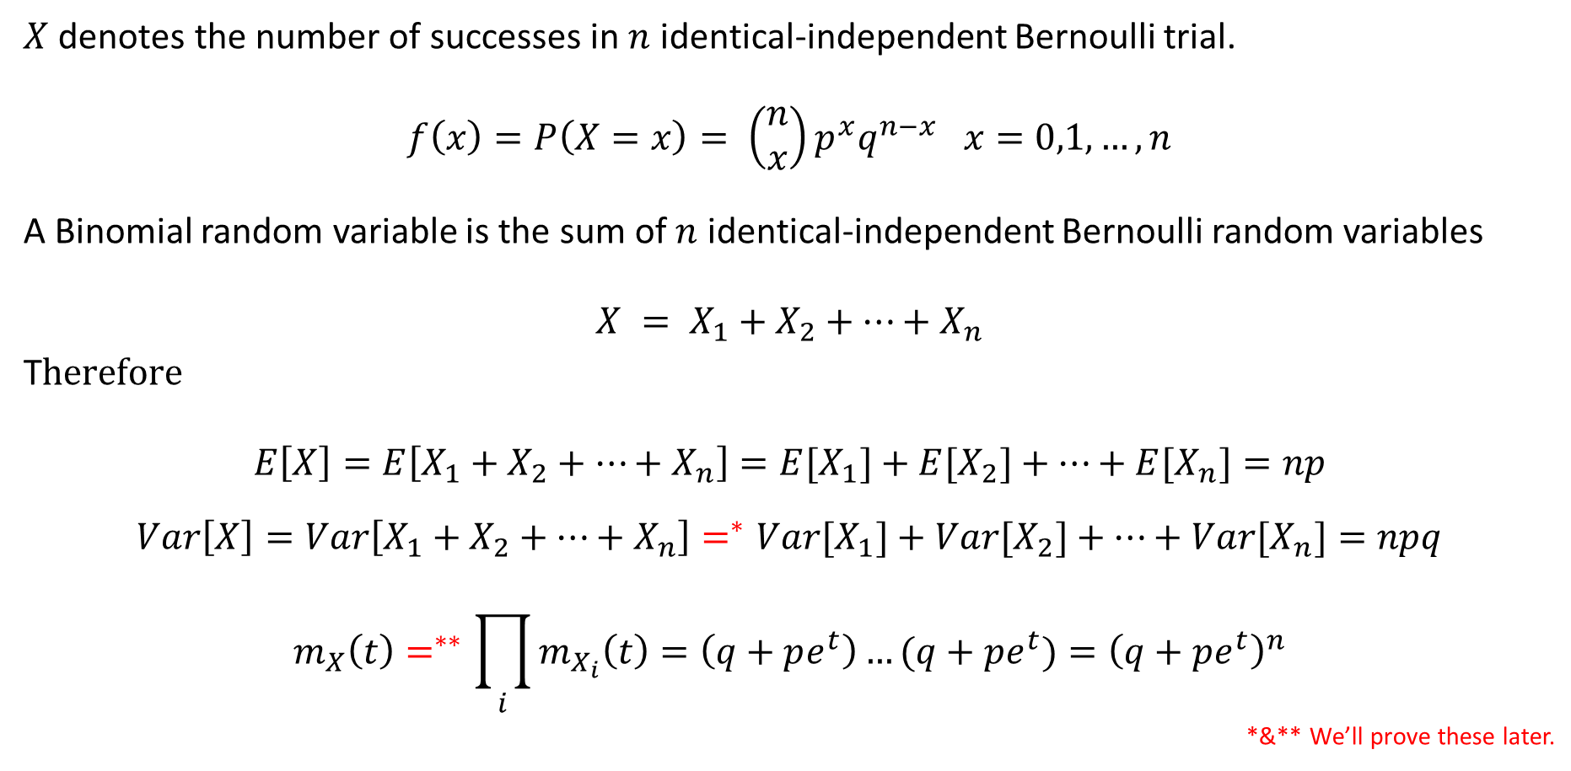
2- Binomial Distribution
$X$ denotes the number of successes in $n$ identical-independent Bernoulli trial.
$$f\left(x\right)=P\left(X=x\right)= \left(\begin{matrix}n \\ x\end{matrix}\right)p^{x}q^{n−x} x=0,1,…,n$$
A Binomial random variable is the sum of $n$ identical-independent Bernoulli random variables
$$X = X_{1}+X_{2}+…+X_{n}$$
T$herefore$
$$E\left[X\right]=E\left[X_{1}+X_{2}+…+X_{n}\right]={E[X}_{1}]+{E[X}_{2}]+…+{E[X}_{n}]=np$$
$$Var\left[X\right]=Var\left[X_{1}+X_{2}+…+X_{n}\right]=^{∗}{Var[X}_{1}]+{Var[X}_{2}]+…+{Var[X}_{n}]=npq$$
$$m_{X}\left(t\right)=^{∗∗}\prod_{i}{m_{X_{i}}\left(t\right)}=\left(q+pe^{t}\right)…(q+pe^{t})={\left(q+pe^{t}\right)}^{n}$$
*&** We’ll prove these later.

Slide 5
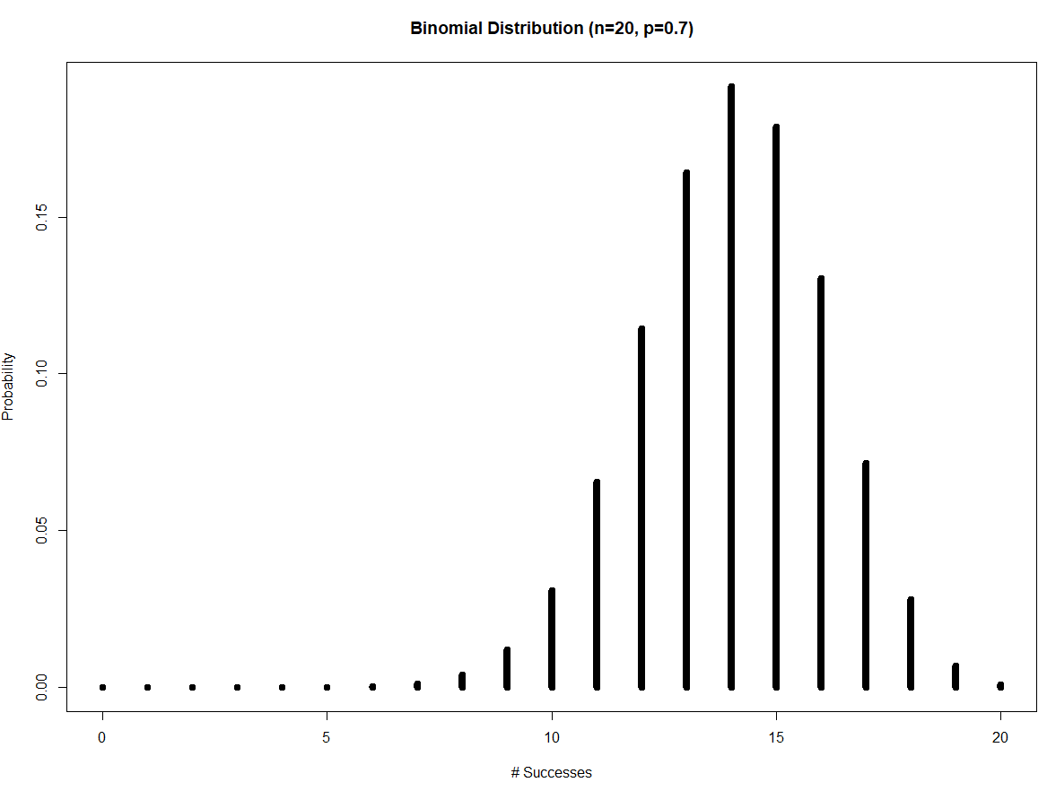
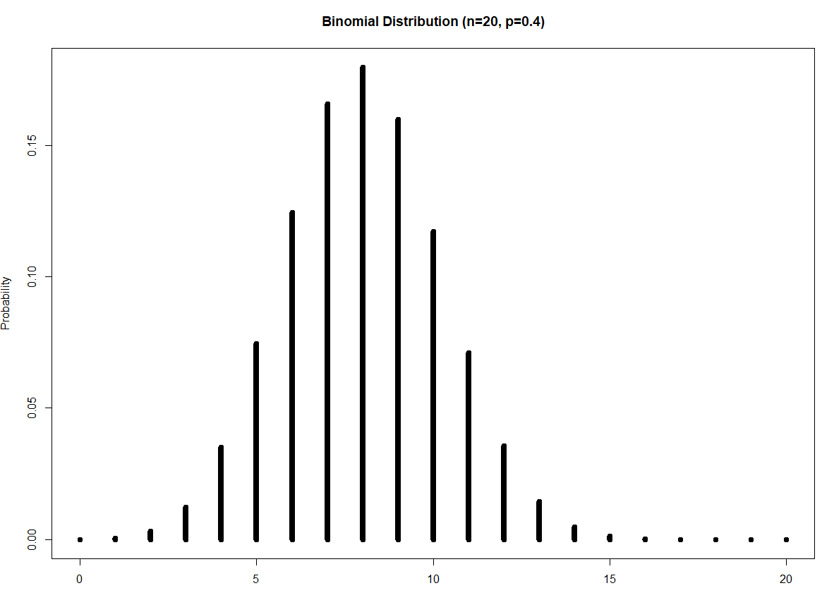

2- Binomial Distribution
For any values of $n$ and $p$, the function $f(x)$ is increasing until “somewhere” and then decreasing. This “somewhere” is actually the “Mode” of the distribution.

Slide 6
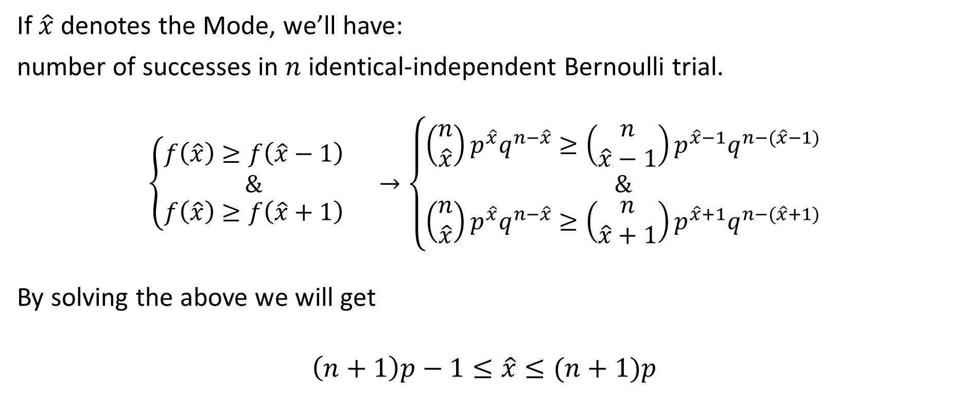
2- Binomial Distribution
If $\hat{x}$ denotes the Mode, we’ll have:
number of successes in $n$ identical-independent Bernoulli trial.
$$\left\{\begin{matrix}\begin{matrix}f\left(\hat{x}\right)≥f\left(\hat{x}−1\right) \\ \&\end{matrix} \\ f\left(\hat{x}\right)≥f\left(\hat{x}+1\right)\end{matrix}\right. →\left\{\begin{matrix}\begin{matrix}\left(\begin{matrix}n \\ \hat{x}\end{matrix}\right)p^{\hat{x}}q^{n−\hat{x}}≥\left(\begin{matrix}n \\ \hat{x}−1\end{matrix}\right)p^{\hat{x}−1}q^{n−(\hat{x}−1)} \\ \&\end{matrix} \\ \left(\begin{matrix}n \\ \hat{x}\end{matrix}\right)p^{\hat{x}}q^{n−\hat{x}}≥\left(\begin{matrix}n \\ \hat{x}+1\end{matrix}\right)p^{\hat{x}+1}q^{n−(\hat{x}+1)}\end{matrix}\right.$$
By solving the above we will get
$$\left(n+1\right)p−1≤\hat{x}≤(n+1)p$$

Slide 7
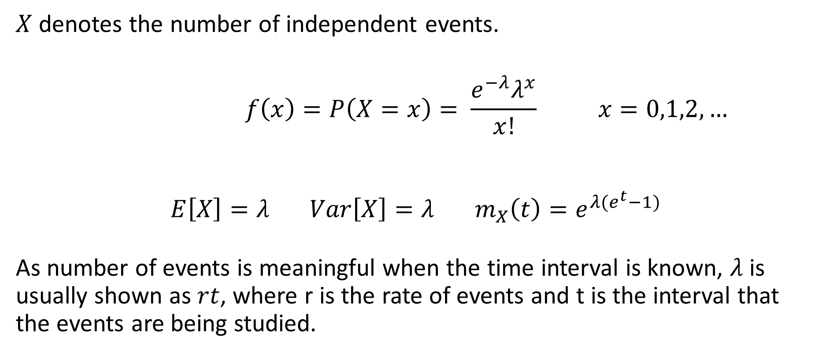
3- Poisson Distribution
$X$ denotes the number of independent events.
$$f\left(x\right)=P\left(X=x\right)= \frac{e^{−λ}λ^{x}}{x!} x=0,1,2,…$$
$$E\left[X\right]=λ Var\left[X\right]=λ m_{X}\left(t\right)=e^{λ(e^{t}−1)}$$
As number of events is meaningful when the time interval is known, $λ$ is usually shown as $rt$, where r is the rate of events and t is the interval that the events are being studied.

Slide 8
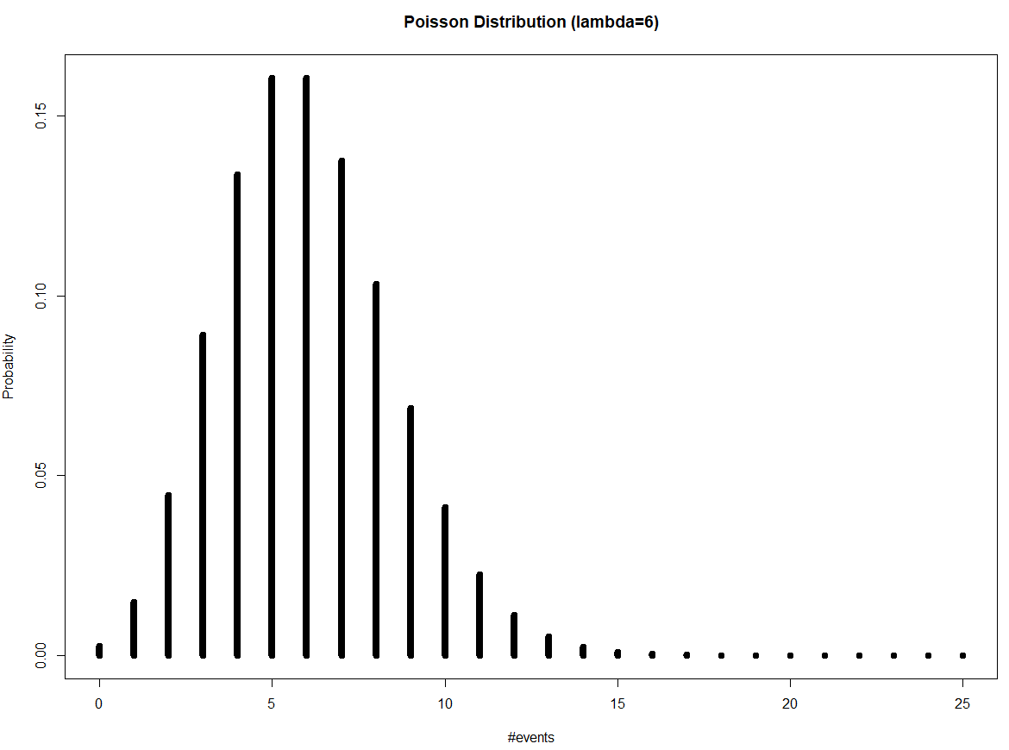
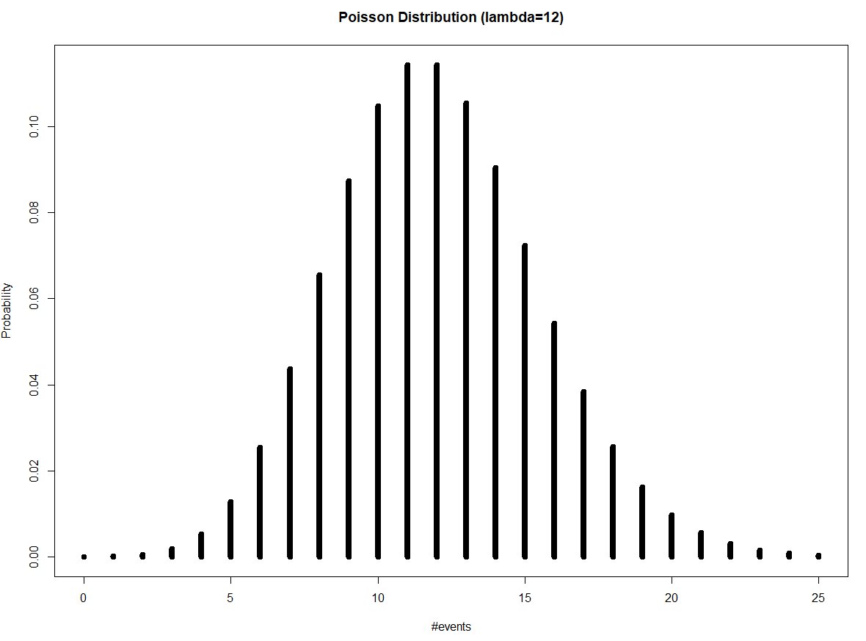

3- Poisson Distribution
For any values of$λ$, the function $f(x)$ is increasing until “somewhere” and then decreasing. This “somewhere” is actually the “Mode” of the distribution.

Slide 9
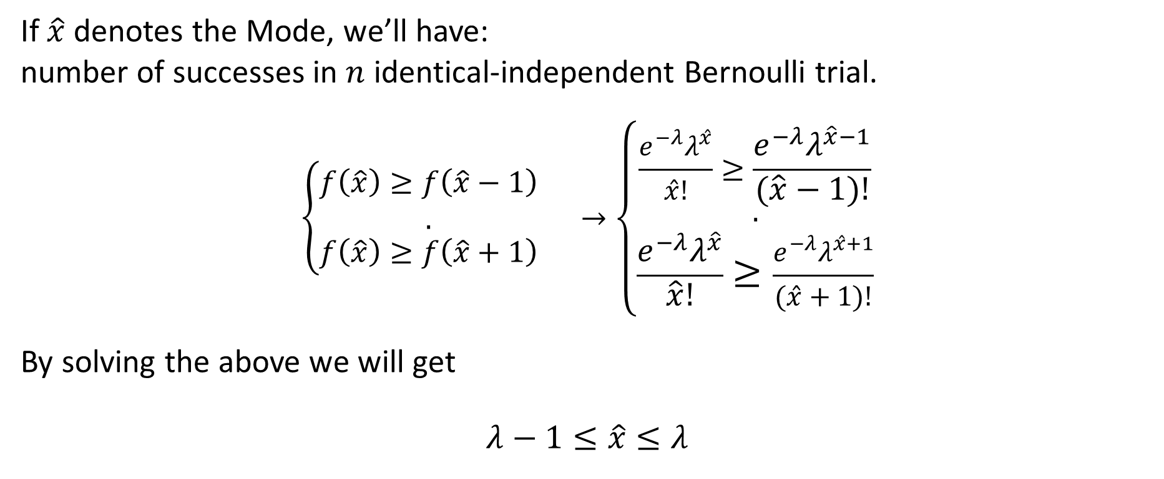
2- Poisson Distribution
If $\hat{x}$ denotes the Mode, we’ll have:
number of successes in $n$ identical-independent Bernoulli trial.
$$\left\{\begin{matrix}\begin{matrix}f\left(\hat{x}\right)≥f\left(\hat{x}−1\right) \\ .\end{matrix} \\ f\left(\hat{x}\right)≥f\left(\hat{x}+1\right)\end{matrix}\right. →\left\{\begin{matrix}\begin{matrix}\frac{e^{−λ}λ^{\hat{x}}}{\hat{x}!}≥\frac{e^{−λ}λ^{\hat{x}−1}}{(\hat{x}−1)!} \\ .\end{matrix} \\ \frac{e^{−λ}λ^{\hat{x}}}{\hat{x}!}≥\frac{e^{−λ}λ^{\hat{x}+1}}{(\hat{x}+1)!}\end{matrix}\right.$$
By solving the above we will get
$$λ−1≤\hat{x}≤λ$$

Slide 10
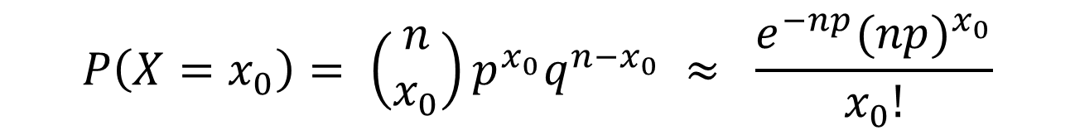
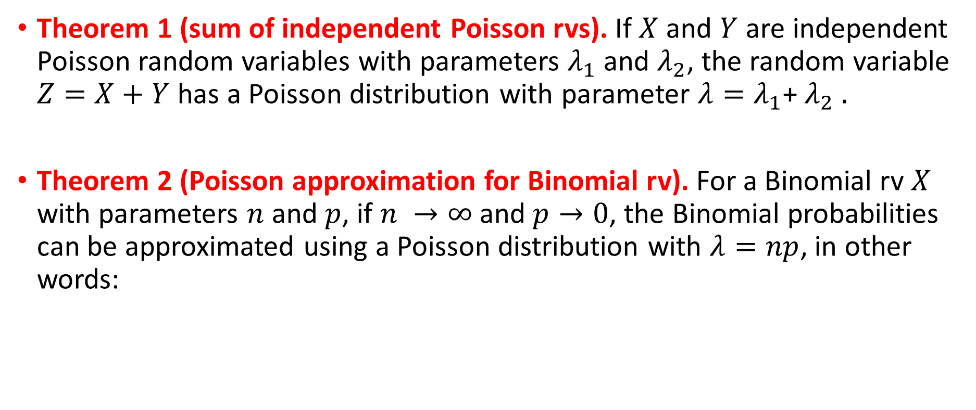
3- Poisson Distribution
Theorem 1 (sum of independent Poisson rvs). If $X$ and $Y$ are independent Poisson random variables with parameters $λ_{1}$ and $λ_{2}$, the random variable $Z=X+Y$ has a Poisson distribution with parameter $λ=λ_{1}$+ $λ_{2}$ .
Theorem 2 (Poisson approximation for Binomial rv). For a Binomial rv $X$ with parameters $n$ and $p$, if $n →∞$ and $p→0$, the Binomial probabilities can be approximated using a Poisson distribution with $λ=np$, in other words:
$$P\left(X=x_{0}\right)= \left(\begin{matrix}n \\ x_{0}\end{matrix}\right)p^{x_{0}}q^{n−x_{0}} ≈ \frac{e^{−np}{(np)}^{x_{0}}}{x_{0}!}$$

Slide 11
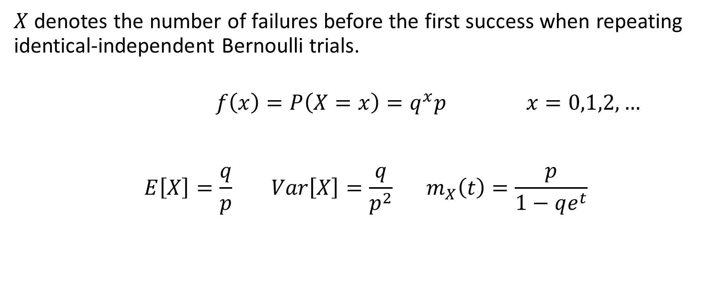
4- Geometric Distribution
$X$ denotes the number of failures before the first success when repeating identical-independent Bernoulli trials.
$$f\left(x\right)=P\left(X=x\right)=q^{x}p x=0,1,2,…$$
$$E\left[X\right]=\frac{q}{p} Var\left[X\right]=\frac{q}{p^{2}} m_{X}\left(t\right)=\frac{p}{1−qe^{t}}$$

Slide 12
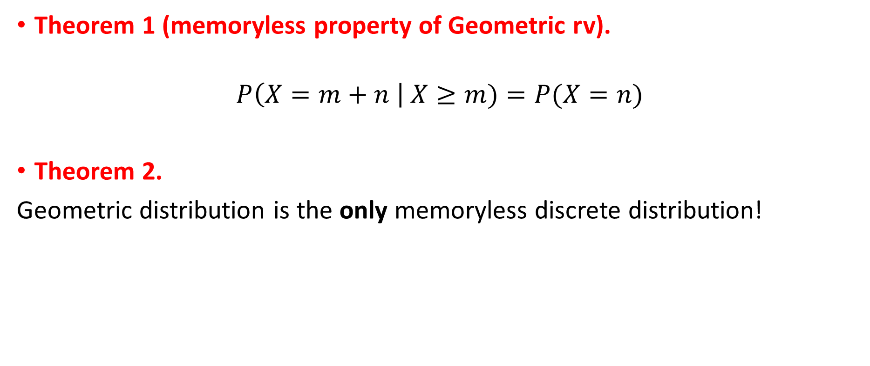
4- Geometric Distribution
Theorem 1 (memoryless property of Geometric rv).
$$P\left(X=m+n \right| X≥m)=P(X=n)$$
Theorem 2.
Geometric distribution is the only memoryless discrete distribution!

Slide 13
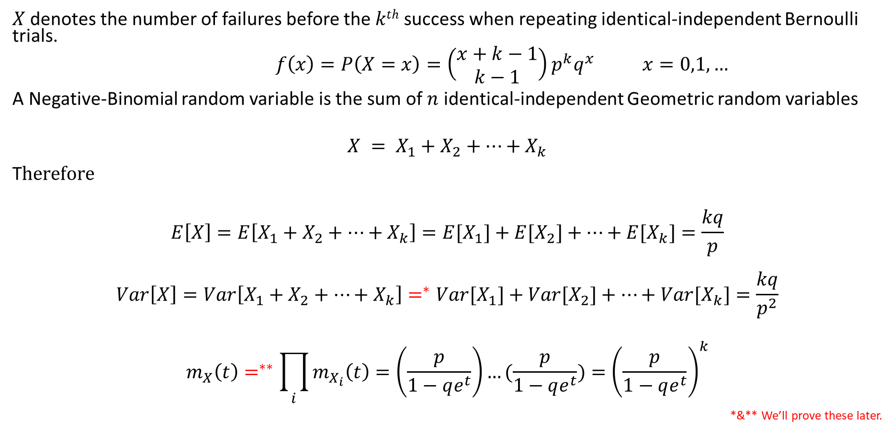
5- Negative-Binomial Distribution
$X$ denotes the number of failures before the $kth$ success when repeating identical-independent Bernoulli trials.
$$f\left(x\right)=P\left(X=x\right)=\left(\begin{matrix}x+k−1 \\ k−1\end{matrix}\right)p^{k}q^{x} x=0,1,…$$
A Negative-Binomial random variable is the sum of $n$ identical-independent Geometric random variables
$$X = X_{1}+X_{2}+…+X_{k}$$
T$herefore$
$$E\left[X\right]=E\left[X_{1}+X_{2}+…+X_{k}\right]={E[X}_{1}]+{E[X}_{2}]+…+{E[X}_{k}]=\frac{kq}{p}$$
$$Var\left[X\right]=Var\left[X_{1}+X_{2}+…+X_{k}\right]=^{∗}{Var[X}_{1}]+{Var[X}_{2}]+…+{Var[X}_{k}]=\frac{kq}{p^{2}}$$
$$m_{X}\left(t\right)=^{∗∗}\prod_{i}{m_{X_{i}}\left(t\right)}=\left(\frac{p}{1−qe^{t}}\right)…(\frac{p}{1−qe^{t}})={\left(\frac{p}{1−qe^{t}}\right)}^{k}$$
*&** We’ll prove these later.

Slide 14
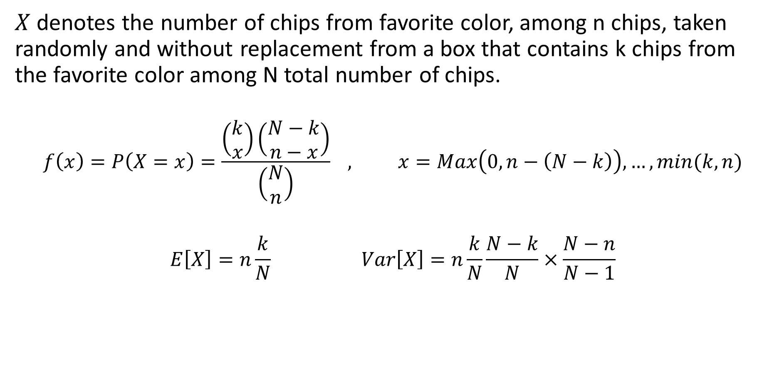
6- Hyper-Geometric Distribution
$X$ denotes the number of chips from favorite color, among n chips, taken randomly and without replacement from a box that contains k chips from the favorite color among N total number of chips.
$$f\left(x\right)=P\left(X=x\right)=\frac{\left(\begin{matrix}k \\ x\end{matrix}\right)\left(\begin{matrix}N−k \\ n−x\end{matrix}\right)}{\left(\begin{matrix}N \\ n\end{matrix}\right)} , x=Max\left(0, n−\left(N−k\right)\right),…, min⁡(k,n)$$
$$E\left[X\right]=n\frac{k}{N} Var\left[X\right]=n\frac{k}{N}\frac{N−k}{N}×\frac{N−n}{N−1}$$

Slide 15
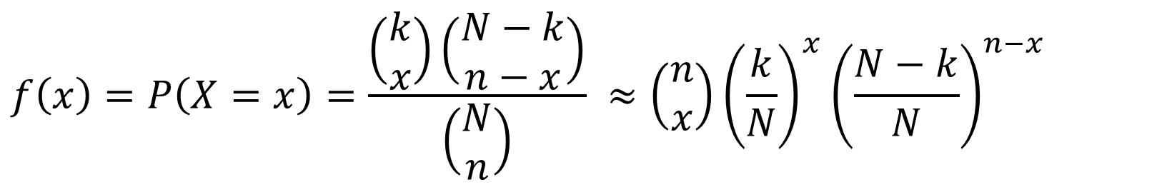

6- Hyper-Geometric Distribution
Theorem (Binomial approximation for Hyper-Geometric rv).
For a Hyper-Geometric rv $X$ with parameters $N,n,k$, if $\frac{n}{N} ≤0.1$, the Hyper-Geometric probabilities can be approximated using a Binomial distribution with $p=\frac{k}{N}$ . In other words: $\left(\frac{k}{N}\right)$
$$f\left(x\right)=P\left(X=x\right)=\frac{\left(\begin{matrix}k \\ x\end{matrix}\right)\left(\begin{matrix}N−k \\ n−x\end{matrix}\right)}{\left(\begin{matrix}N \\ n\end{matrix}\right)} ≈\left(\begin{matrix}n \\ x\end{matrix}\right){\left(\frac{k}{N}\right)}^{x}{\left(\frac{N−k}{N}\right)}^{n−x}$$

Slide 16

7- Uniform Distribution
$X$ denotes the observed number on a card, taken randomly from a set of numbered cards from $1$ to $n$.
$$f\left(x\right)=P\left(X=x\right)=\frac{1}{n} , x=1, 2, …, n$$
$$E\left[X\right]=\frac{n+1}{2} , Var\left[X\right]=\frac{n^{2}−1}{12} , m_{X}\left(t\right)= \frac{1−e^{\left(n+1\right)t}}{n\left(1−e^{t}\right)}$$

